Slide 1
MISSINGPEOPLEINFO.COM
A Presentation for Volunteer

Slide 2
Who is a Volunteer of Our Initiative
Any Person who wants to upload information about missing people can be our volunteer
Our Volunteers need to always be alert and keep on looking for suspicious activities around them. They can click pictures of beggers , or child labourers or any person/child looking lost in public area.
A volunteer who want to be a part of this initiative he/she has to fill a small form and we will guide him/her ahead. This will involve field activities and guiding complainants to register with our website

Slide 3
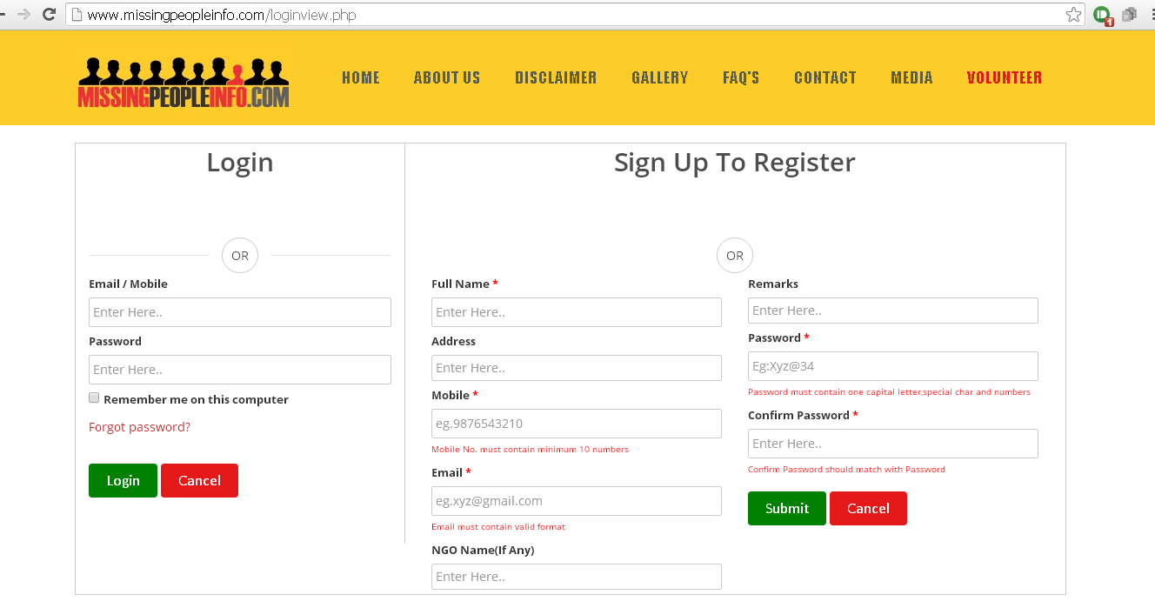
Sample image of VOLUNTEER FORM

Slide 4
Steps to be followed to become VOLUNTEER
In order to upload information a volunteer will have to login to our website www.missingpeopleinfo.com and click on the button “VOLUNTEER”
The person who registers as VOLUNTEER has to fill all details that is mentioned in form like name, number, address so that it can be stored in our database and can be used for further communication when he is on field.
The person who will be volunteer will be on field so if we get a missing report from a particular area we can contact that volunteer and take further steps.

Slide 5
A Volunteer who wants to upload information
Our Volunteer who wants to upload information about missing people can click on “I WANT TO HELP”
People need to always be alert and keep on looking for suspicious activities around them. They can click pictures of beggars, or child laborers or any person/child looking lost in public area.
The person has to enter details of missing person, like images of that person, when and where they were last seen and their name if possible.

Slide 6
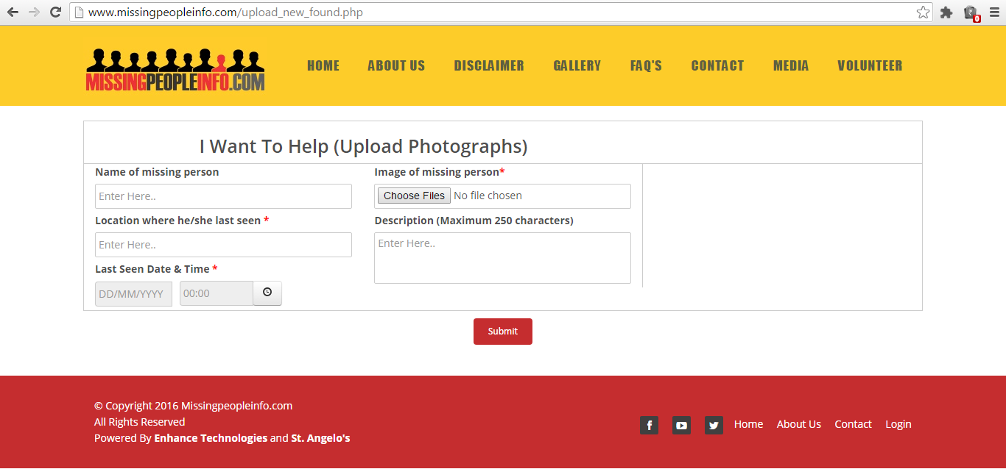
Sample image of I WANT TO HELP

Slide 7
HOW TO UPLOAD IMAGES
It is not necessary that you can upload images only by clicking the picture of the person live.
If you have the details of missing person on social networking sites like facebook, twitter of any other such platform you can upload those images also.
You have to save these picture into mobile or desktop and then upload on missingpeopleinfo.com website
If the image is in hard copy. They picture of the same can be clicked from Mobile and uploaded on our website.

Slide 8
Thank You

